Slide 1
Cognitive Development

Slide 2
Cognition – thinking
Perception, learning, memory, reasoning
Theories of Cognitive Development
- Piaget
- Vygotsky
Language Development
The Brain and Language

Slide 3
Piaget
Piaget taught in The Grange aux Belles
school for boys in Paris
Noticed similar errors in the same age group
Distinct age related ways of thinking and understanding the world

Slide 4
Child’s mind develops through a series of stages
Schemas – mental moulds
Assimilate new experiences
Accommodate our schemas to incorporate new experiences

Slide 5
Sensorimotor: 0-2yrs experiencing the world through senses and actions.
Object permanence and Stranger Anxiety
Preoperational: 2-6/7 representing things with words and images, intuitive thinking
Pretend play, Egocentrism
Concrete Operational: 7-11 thinking logically about concrete events, arithmetic
Conservation, Mathematical Transformations
Formal Operational: 12 – adulthood
abstract reasoning, logic, mature moral reasoning
Notes:
Objects continue to exist even when we longer see them.

Slide 6
Sensorimotor
born with reflexes – sucking, grasping
motor development – moving, sitting, crawling, standing, walking
Seeks stimulation, captivated by interesting spectacles, explores
Awareness of agency (I can make something happen)
Intentionality
Imaginative play
Beginning of language

Slide 7
Preoperational
Ability to represent objects using symbols
Animistic Thinking
Egocentrism
Intuitive – may use mental operations such as classifying, quantifying - but may not be aware of it.
Irreversibility
Focus on ends rather than means
Notes:
Egocentrism: believe themselves to be the center of everything/universe
Piaget also studied relatively primitive thinking in children, a form of which is labelled animistic thinking. Animistic thinking is a mode of thinking which involves attributing life to an inanimate object.

Slide 8
Concrete Operational
More flexible in their thinking
Conservation
Organize (classes, sub classes)
A is taller than B, B is taller than C
(working memory)

Slide 9
Formal Operations
Abstract Thought
Hypothetical Thinking
Logical
Can go beyond unrealistic content to focus on the logic
Increased Complexity

Slide 10
Children are active constructors of knowledge
Development follows a sequence
Errors are informative and give us clues about children’s thinking as they struggle to understand reality
Cognitive Development in the early years is perceptual motor not language based

Slide 11
Culture and the historical era - influence development
Stage wise Development ?
May have underestimated abilities

Slide 12
Vygotsky
Born in Russia
Law Degree
1917 – Russian Revolution
Notes:
Early development occurs through social interaction and parental instruction, put a lot of affect on language :monkey example

Slide 13
Marx
Human capacity for tool use and production
What people think depends on their material life
Engels
- tool use
- communication
Technology created a new orientation to the environment
- Planning

Slide 14
Psychological Tools – master behavior - Signs
Signs – mediators that account for shifts in development
speech, numbers, algebraic symbols, art enable better cognitive representation of the world and problem solving

Slide 15
Human behavior is understood in the context of the signs of the culture
Speech - words free our thoughts and attention from the present situation.
“speech enables us to reflect upon the past and plan for the future” Vygotsky, 1930

Slide 16
Children cannot develop purely abstract modes of thought without instruction in abstract sign system.
Seen in technologically advanced societies

Slide 17
1931 – soviet govt phasing in adult education in remote regions
Luria - central Asia
In the Far North, where there is snow, all bears are white. Novaya is in the Far North. What colour are the bears there?
Luria, 1976

Slide 18
Zone of Proximal Development – With adult guidance the range of potential development exceeds what can be achieved alone

Slide 19
The Role of Culture
Apprenticeship – weaving, pottery
Social Interaction plays a fundamental role
in cognitive development

Slide 20
‘Thought and Language’
external speech – social context
inner speech - gradually internalized
tool for self regulation
Speech – turning thought into words and inner speech is the conversion of speech into inward thought.

Slide 21
Play - transitional stage
pretend play – relationship with everyday objects changes – becomes more abstract
Role play - rules – self regulation
“Tools of the mind”
executive function - to stay focused

Slide 22
As the tools of thinking in a culture change the mind takes on a new character
Vygotsky

Slide 23
Language Development
Babbling – 3mnths -1yr
speechlike meaningless sounds
Language Comprehension
Telegraphic Speech
Overgeneralization – apply rules everywhere
Notes:
By the time 1 yr old – sounds not in their language disappear
Consonnants - b d p m t
Comprehension precedes production - simple instructions – come here, where is the fan?, open your mouth,
2 yrs 50 words

Slide 24
The Learning Theory Approach – language acquisition occurs thru principles of reinforcement and conditioning
What about learning rules?
Chomsky - innate linguistic ability that emerges as a function of maturation
Language Acquisition Device – permits understanding the structure of language and
unique characteristics of the language.language is hard wired inside out mind
Notes:
More parents speak to their children – better acquisition more sophisticated better dev

Slide 25
Language
Language – tool of communication
Linguistic Competence – universal human species typical ability
Language elements
Syntax
Semantics
Pragmatics

Slide 26
Language Elements
Phones - speech sounds (produced)
Phonemes – mental representations
phones that are categorized
Syllables - smallest unit of speech perception
Words, clauses, sentences
Notes:
Categorical perception of phonemes
languages – differ in their groupings of phonemes – hence the problem in learning new language

Slide 27
Syntax -Grammar
Theory of Transformational Grammar
(Chomsky, 1957, 1965)
phrase structure rules
deep phrase structure
surface structure
Notes:
The goose crossed the road
The road was crossed by the goose – transformation – maintains the meaning
Did the goose cross the road
The goose did not cross
Why did the goose cross?
Transforming the surface structure but the deep structure remains the same.

Slide 28
Semantics Meanings of words
Concepts –
“family resemblance structures” (Wittgenstein, 1953)
Prototypes
denotational vs connotative meaning
We know the meaning of a word by hearing the way other members of our group use them (scope in insti) …meaning is use

Slide 29
Pragmatics
Context and Situation
Sarcasm
Status
Conversation Rules
Notes:
Pragmatics interopretations of words…

Slide 30
Finer aspects of grammar – mastery was related to age at which language had been learned (7-8 years seemed to be the cut off) (Johnson & Newport, 1989) if one is not exposed to language till age 7 then it will be hard to dev. language
“Yesterday the hunter shoots a deer”
Notes:
Primary language is represented in the left hemisphere
But the second language if learnt later – is represented in a separate area

Slide 31
Language Influences Thinking?
Linguistic Relativity Hypothesis (Whorf, 1956) language shapes and determines how people of a particular culture perceive or understand the world
Different languages represent different ways of thinking…….often its wrong
Color Perception
Perceived differences grow when we assign different color names
Notes:
Hopi – no past tense
Eskimos – more words for snow

Slide 32
Abstract ideas -conceptualized through language
Thinking in Images
mental practice
Notes:
Liu Chi Kung – pianist – imprisoned for 7 years Cultural Revolution……but could still play piano

Slide 33
Gestures
Chimps –natural gestures (tool users)
Pave the way for children’s language
Signed language readily develops among deaf
Gesture on the phone
Congenitally blind people gesture
Lightens cognitive load
Notes:
Children learns language from their parents. Even animals do

Slide 34
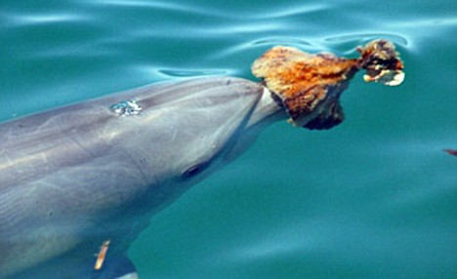
Bottlenose Dolphin wearing a sea sponge

Slide 35
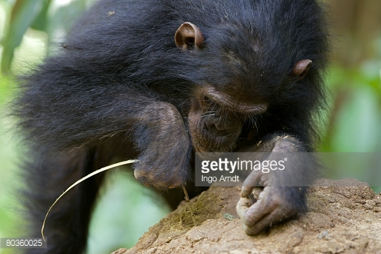

Slide 36
Animal Learning
Project Washoe – American Sign Language – 176 signs
string words into a sentence
“You me go out, please”
Water bird when she saw a swan
Notes:
signed -
Give me apple which is orange - Lana
You me go out please

Slide 37
Loulis – Washoe’s adopted baby picked up 66 signs through observation..(children learn from parents)
Sign amongst each other – come, tickle, hug ..
Early exposure to language seems to be critical

